Slide 1

Department of CE
Unit no: 5
Unit title : Cryptographic Hash Functions
Information and Network Security and 2170709

Slide 2
MD5 ---(Message Digest 5)
Opening :
• MD5 algorithm can be used as a digital
signature mechanism.
• This presentation will explore the
technical aspects of the MD5 algorithm.

Slide 3
Description of the MD5 Algorithm
• Takes as input a message of arbitrary length and produces as output a 128 bit “fingerprint” or
“message digest” of the input.
• Intended where a large file must be “compressed” in a secure manner before being encrypted with a private key under a public-key cryptosystem such as PGP.

Slide 4
MD5 Algorithm
Md is also called a hash code.
Suppose a b-bit message as input, and
that we need to find its message digest.
Input text is divided into blocks of 512 bits initially further divided into 32 bits of 16 sub block.
Output of algo. Is a set of four 32 bit – blocks.

Slide 5

MD5 Algorithm

Slide 6
MD5 Algorithm
• Step 1 – append padded bits:
– The message is padded so that its length is
congruent to 448, modulo 512.
• Means extended to just 64 bits shy of being of
512 bits long.
– A single “1” bit is appended to the message,
and then “0” bits are appended so that the
length in bits equals 448 modulo 512.

Slide 7
MD5 Algorithm
Out put of Step No: 1
1472 Bits
1000 Bits
472 Bits

Slide 8
MD5 Algorithm
• Step 2 – append length:
– A 64 bit representation of b is appended to
the result of the previous step.
– The resulting message has a length that is
an exact multiple of 512 bits

Slide 9
MD5 Algorithm
Out put of Step No: 2
1536
Total Bits Are:
1000 Bits
472 Bits
64 Bits

Slide 10
MD5 Algorithm
• Step 3 –
Initialize MD Buffer or chaining variables
• A four-word buffer (A,B,C,D) is used to
compute the message digest.
– Here each of A,B,C,D, is a 32 bit register.

Slide 11
MD5 Algorithm
• Step 3 cont.- divide 512- bit block into 16-sub block and each sub block contain 32 bits.
• These registers are initialized to the
following values in hexadecimal:
word A: 01 23 45 67
word B: 89 ab cd ef
word C: fe dc ba 98
word D: 76 54 32 10

Slide 12
MD5 Algorithm
• Step 4 – Process message in 16-word blocks.
– Four auxiliary functions that take as input three 32-bit words and produce as output one 32-bit word.
F(X,Y,Z)=(X&&Y)||(!X&&Z)
G(X,Y,Z)=(X&&Z)||(Y&&!Z)
H(X,Y,Z)=X^^Y^^Z
I (X,Y,Z)=Y^^(X||!Z)
( b AND c ) OR ( ( NOT b ) AND ( d ) )
( b AND d ) OR ( ( c ) AND ( NOT d ) )
B X’OR C X’OR D
C X’OR ( b OR ( NOT d ) )

Slide 13
MD5 Algorithm
• Step 4 – Process message in 16-word
blocks cont.
– if the bits of X, Y, and Z are independent and
unbiased, the each bit of F(X,Y,Z), G(X,Y,Z),
H(X,Y,Z), and I(X,Y,Z) will be independent
and unbiased.

Slide 14
MD5 Algorithm
• Step 5 – output
– The message digest produced as output is
A, B, C, D.
– That is, output begins with the low-order byte
of A, and end with the high-order byte of D.

Slide 15
MD5 Algorithm
One MD5 operation. MD5 consists of
64 of these operations, grouped in four
rounds of 16 operations.
F is a nonlinear function; one function is
used in each round. Mi denotes a 32-
bit block of the message input, and Ki
denotes a 32-bit constant, different for
each operation.

Slide 16
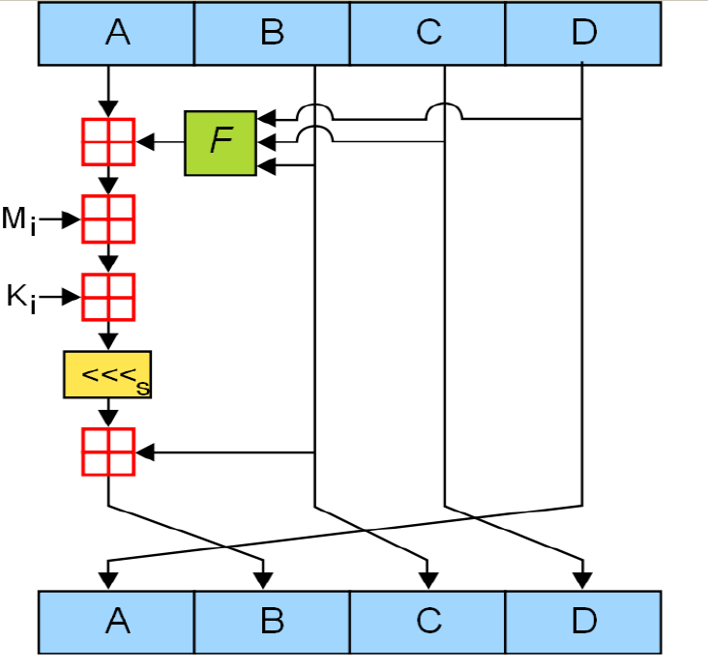
MD5 Algorithm
There are four possible
functions F;
a different one is used in
Each round:
F(X,Y,Z)=(X&&Y)||(!X&&Z)
G(X,Y,Z)=(X&&Z)||(Y&&!Z)
H(X,Y,Z)=X^^Y^^Z
I (X,Y,Z)=Y^^(X||!Z)
&& - logical and
! - logical not
|| -logical or
^^ -logical X-OR

Slide 17
SHA ---(Secure Hash Algorithm)
Opening :
• SHA algorithm can be used as a digital
signature mechanism.
• This presentation will explore the
technical aspects of the SHA algorithm.

Slide 18
Description of the SHA Algorithm
• Takes as input a message of arbitrary length and produces as output a 160 bit “fingerprint” or
“message digest” of the input.
• Intended where a large file must be “compressed” in a secure manner before being encrypted with a private key under a public-key cryptosystem such as PGP.

Slide 19
SHA Algorithm
SHA is also called a hash code or hash value or hash digest.
Suppose a b-bit message as input, and
that we need to find its message digest.
Input text is divided into blocks of 512 bits initially further divided into 32 bits of 16 sub block.
Output of algo. Is a set of four 32 bit – blocks.

Slide 20
SHA Algorithm
• Step 1 – append padded bits:
– The message is padded so that its length is
congruent to 448, modulo 512.
• Means extended to just 64 bits shy of being of
512 bits long.
– A single “1” bit is appended to the message,
and then “0” bits are appended so that the
length in bits equals 448 modulo 512.

Slide 21
SHA Algorithm
• Step 1 – append padded bits:
– The message is padded so that its length is
congruent to 448, modulo 512.
• Means extended to just 64 bits shy of being of
512 bits long.
– A single “1” bit is appended to the message,
and then “0” bits are appended so that the
length in bits equals 448 modulo 512.

Slide 22
SHA Algorithm
Out put of Step No: 1
1984 Bits
1701 Bits
283 Bits

Slide 23
SHA Algorithm
• Step 2 – append length:
– A 64 bit representation of b is appended to
the result of the previous step.
– The resulting message has a length that is
an exact multiple of 512 bits

Slide 24
SHA Algorithm
1701 Bits
283 Bits
64 Bits
Out put of Step No: 2
2048
2048
Total Bits Are:
Total No. of Blocks of 512 are : ???

Slide 25
SHA Algorithm
• Step 3 –
Initialize SHA Buffer or chaining variables
• A five-word buffer (A,B,C,D,E) is used to
compute the message digest.
– Here each of A,B,C,D, E is a 32 bit register.

Slide 26
SHA Algorithm
• Step 3 cont.- divide 512- bit block into 16-sub block and each sub block contain 32 bits.
• These registers are initialized to the
following values in hexadecimal:
word A: 01 23 45 67
word B: 89 ab cd ef
word C: fe dc ba 98
word D: 76 54 32 10
word E: C3 D2 E1 F0

Slide 27
SHA Algorithm
• Step 4 – Process message in 16-word blocks.
– Four auxiliary functions that take as input three 32-bit words and produce as output one 32-bit word.
F(X,Y,Z)=(X&&Y)||(!X&&Z)
G(X,Y,Z)= X^^Y^^Z
H(X,Y,Z)=(X&&Y) ||(X&&Z) ||
(Y&&Z)
I (X,Y,Z)= X^^Y^^Z
( b AND c ) OR ( ( NOT b ) AND ( d ) )
B X’OR C X’OR D
( b AND c ) OR ( b AND d ) OR ( c AND d )
B X’OR C X’OR D

Slide 28
SHA Algorithm
For t from 16 to 79 or 17 to 80
Wt = (Wt-3 ⊕ Wt-8 ⊕ Wt-14 ⊕ Wt-16) <<< 1
For Round 1 to 20 : ( b AND c ) OR ( ( NOT b ) AND ( d ) )
For Round 21 to 40 : B X’OR C X’OR D
For Round 41 to 60 : ( b AND c ) OR ( b AND d ) OR ( c AND d )
For Round 61 to 80 : B X’OR C X’OR D

Slide 29
SHA Algorithm
• Step 4 – Process message in 16-word
blocks cont.
– if the bits of X, Y, and Z are independent and
unbiased, the each bit of F(X,Y,Z), G(X,Y,Z),
H(X,Y,Z), and I(X,Y,Z) will be independent
and unbiased.

Slide 30
SHA Algorithm
• Step 5 – output
– The message digest produced as output is
A, B, C, D.
– That is, output begins with the low-order byte
of A, and end with the high-order byte of D.

Slide 31
SHA Algorithm
One SHA operation. SHA consists of
80 of these operations, grouped in four
rounds of 20 operations.
F is a nonlinear function; one function is
used in each round. Wt denotes a 32-
bit block of the message input, and K(t)
denotes a 32-bit constant, different for
each operation.

Slide 32
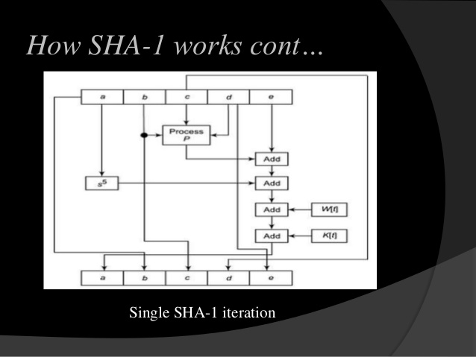
SHA Algorithm
There are four possible
functions F;
a different one is used in
Each round:
F(X,Y,Z)=(X&&Y)||(!X&&Z)
G(X,Y,Z)=(X&&Z)||(Y&&!Z)
H(X,Y,Z)=X^^Y^^Z
I (X,Y,Z)=Y^^(X||!Z)
&& - logical and
! - logical not
|| -logical or
^^ -logical X-OR

Slide 33
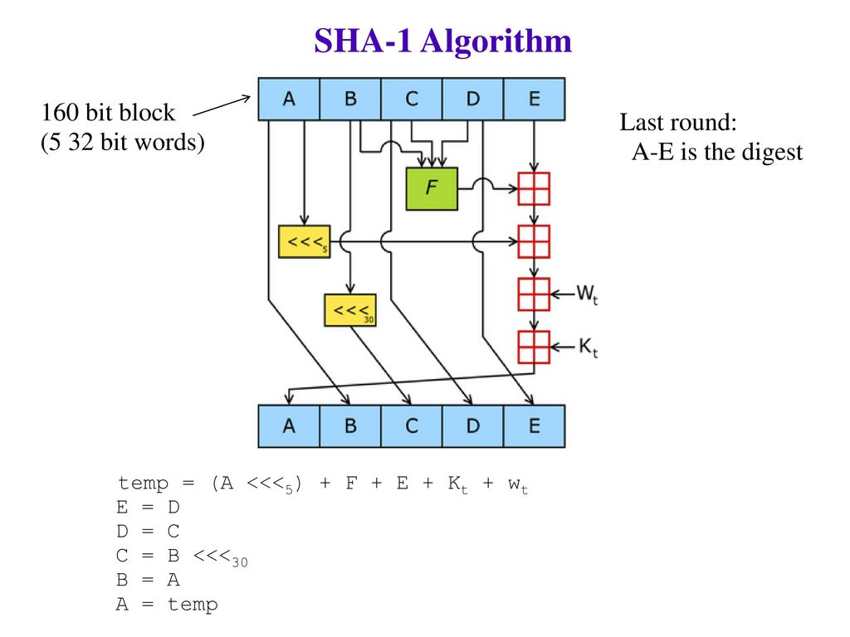
SHA - I

Slide 34

Summary of SHA Algorithm

Slide 35
Thank You!
Any Question…

